Slide 1

TO DO LIST
Stay ahead of your day with a tool that turns intentions into accomplishments. Our To-Do List app is designed to simplify your tasks, helping you organize, prioritize, and achieve with ease. Make productivity a habit, one checkmark at a time!
NAME: Nandini Sharma
SECTION: 3-B
ROLL NO. : 2300290120145

Slide 2
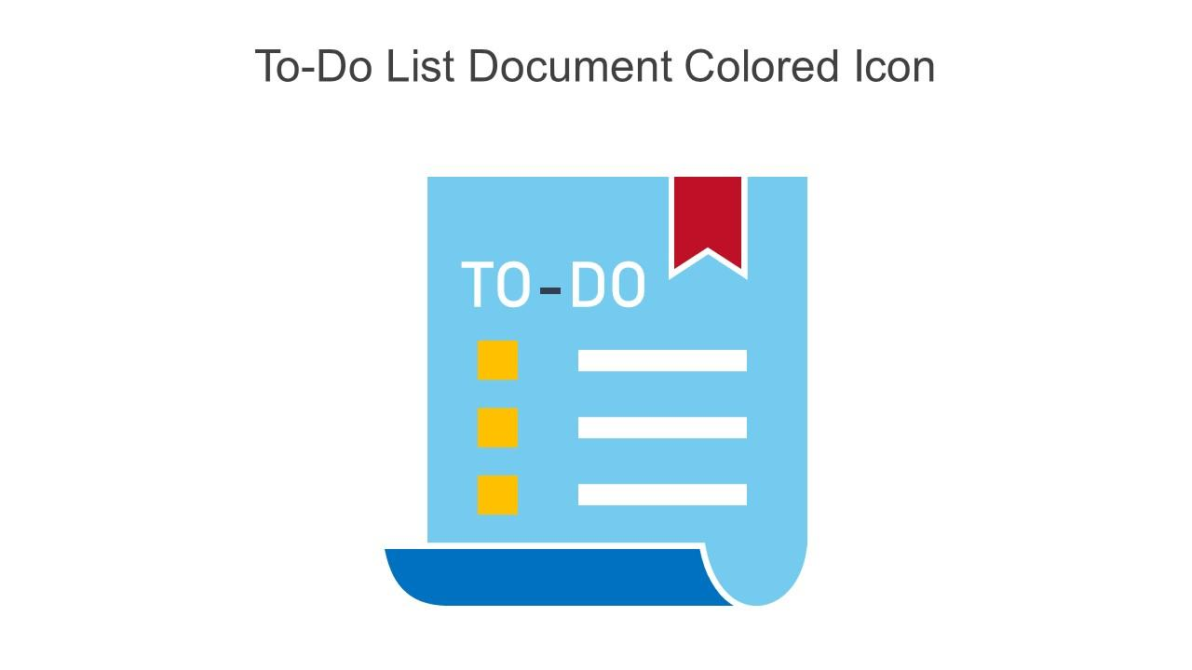
INTRODUCTION
In today’s fast-paced world, staying organized is crucial. This project aims to create a simple and effective To-Do List application to help users manage their tasks efficiently.

Slide 3
PROBLEM STATEMENT
Many individuals struggle to keep track of their daily tasks, leading to missed deadlines and increased stress .
Existing solutions can be overwhelming or too simplistic, lacking the features users need.

Slide 4
SOLUTION TO ADDRESS PROBLEM
Our solution is a user-friendly To-Do List web application .
Key features include task addition, deletion, and marking tasks as completed. The app is designed for simplicity and ease of use.

Slide 5



TECH STACK

Slide 6
METHODOLOGY
1. Research: Understanding user needs and existing solutions.
2. Design: Creating wireframes and mockups.
3. Development: Building the application using HTML, CSS, and JavaScript.
4. Testing: Ensuring functionality and user experience.
5. Deployment: Making the app accessible online.

Slide 7
BENEFITS
1. User-friendly Interface: Easy to navigate and use.
2. Task Management: Helps users stay organized.
3. Customization: Users can personalize their experience.
4. Accessible: Available on any device with a web browser.

Slide 8
WORKING OF THE PROJECT
The application allows users to:
Add new tasks with a simple input form.
View the list of tasks with options to delete or mark them as completed .
Tasks are stored in the browser's local storage for persistence.

Slide 9
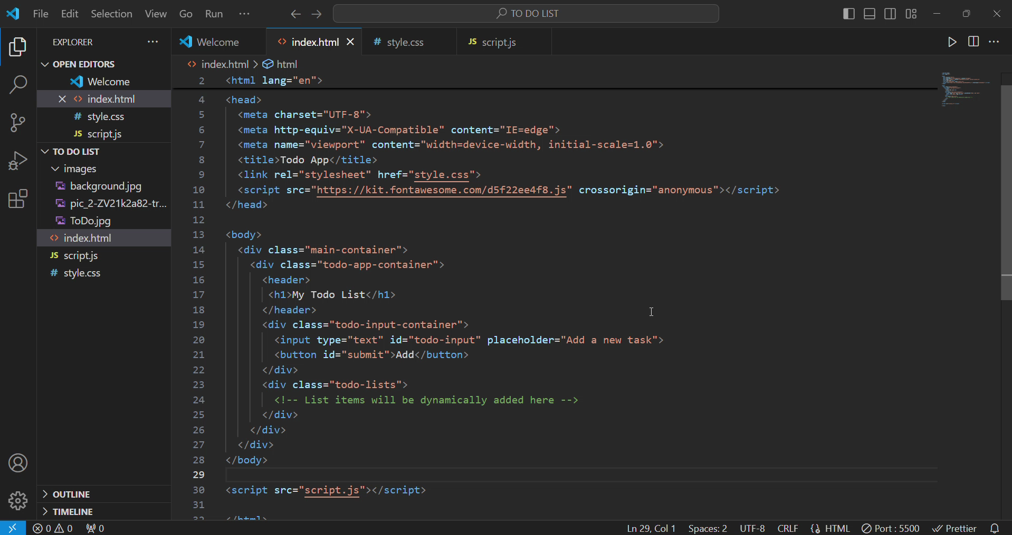

Slide 10
CONCLUSION
This To-Do List web application is a practical tool for anyone looking to improve their productivity .
By leveraging HTML, CSS, and JavaScript, we've created an accessible and efficient solution to task management.

Slide 11

Thank You!

